Slide 1





Integrating E-books and the Web
D.C. Denison

Slide 2

Notes:
The nook

Slide 3

Notes:
The kindle

Slide 4


Slide 5

Notes:
The skiff

Slide 6
E-Reader marketing messages
Convenience/Connectivity
Storage

Slide 7
<Hyperlinking>

Slide 8
E-Readers that can hyperlink
Kindle
Sony Reader
Stanza on the iPhone
Bookworm
Vook
Formats: ePub, PDF, mobi, azw

Slide 9
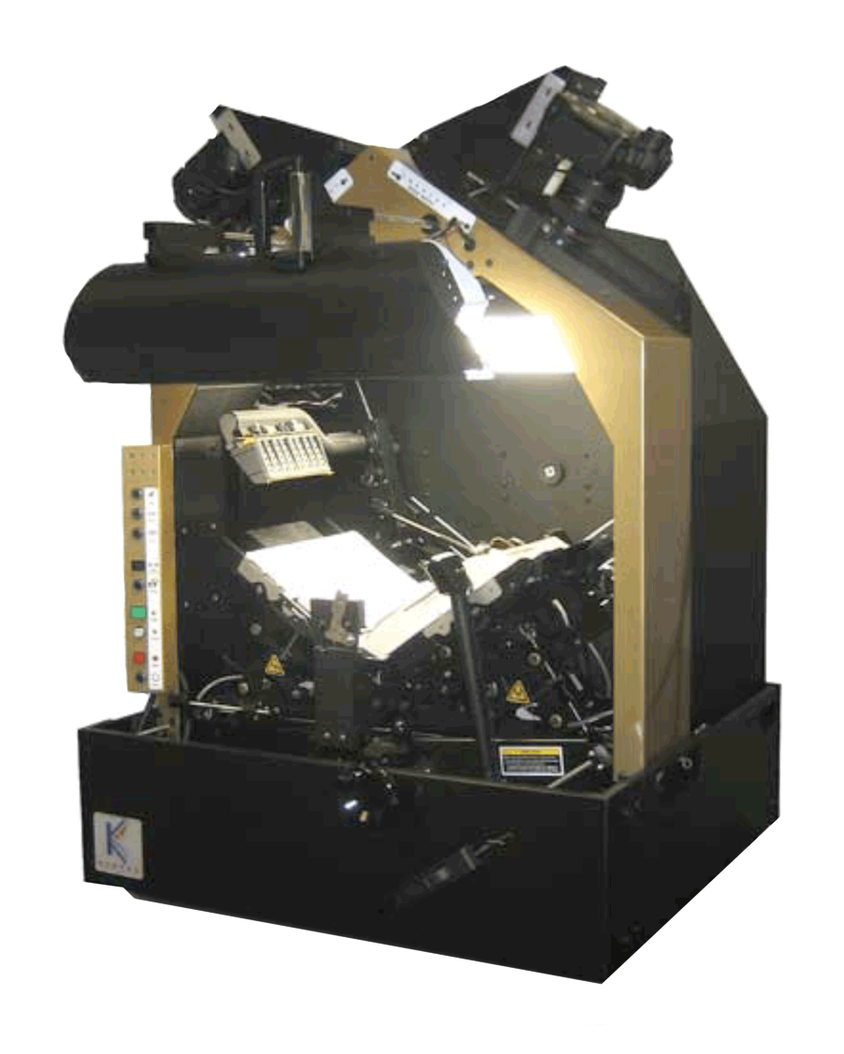

Slide 10

Publishing Workflow

Slide 11

The workflow result
Ebook and website don’t talk to each other

Slide 12

Notes:
NEW – Feb. 7, 2010

Slide 13

Notes:
NEW – Feb 7, 2010

Slide 14

Notes:
Photo by jonno259
http://www.flickr.com/photos/jonno259/

Slide 15

Notes:
Photo by sean dreilinger
http://www.flickr.com/photos/seandreilinger/

Slide 16
Hyperlinking: Advantages
Tighter integration with the Web
Updatable
Interactive, responsive
Digressions, amplifications
Access to source material
Access to new, alternate versions
Add multimedia elements

Slide 17

Notes:
f.yamada
http://www.flickr.com/photos/loxea/

Slide 18
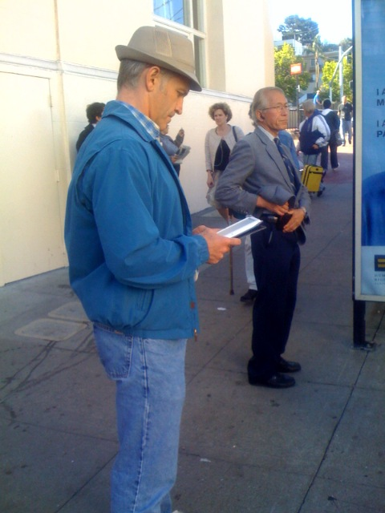
Notes:
Photo by Nick Starr
http://www.flickr.com/photos/nickstarr/

Slide 19

Notes:
Photo by colorblindPICASO
http://www.flickr.com/photos/colorblindpicaso/

Slide 20

Notes:
Photo by Steve Rhodes
http://www.flickr.com/photos/ari/

Slide 21
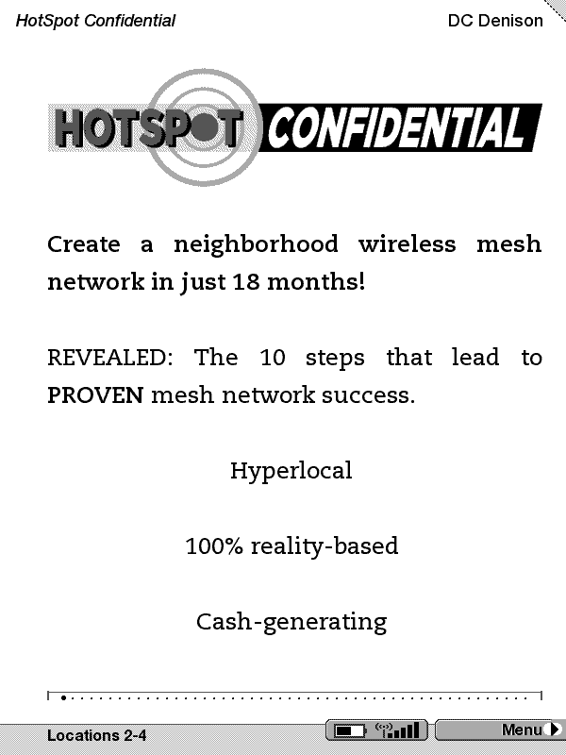

Slide 22
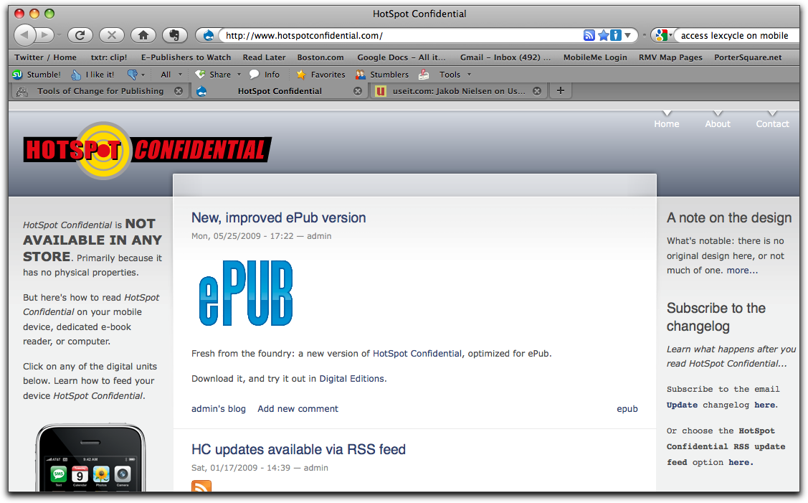

Slide 24
My Workflow

Slide 25
Instead of this:
E-book and website don’t talk to each other

Slide 26
Ebook and Website talking to each other

Slide 27
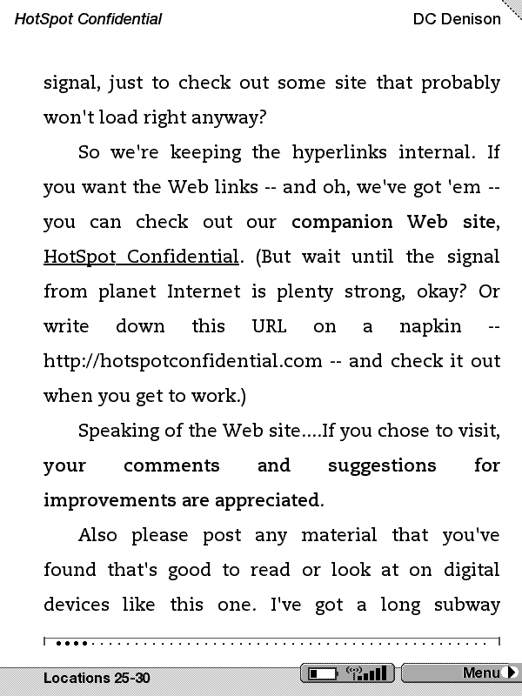

Slide 28
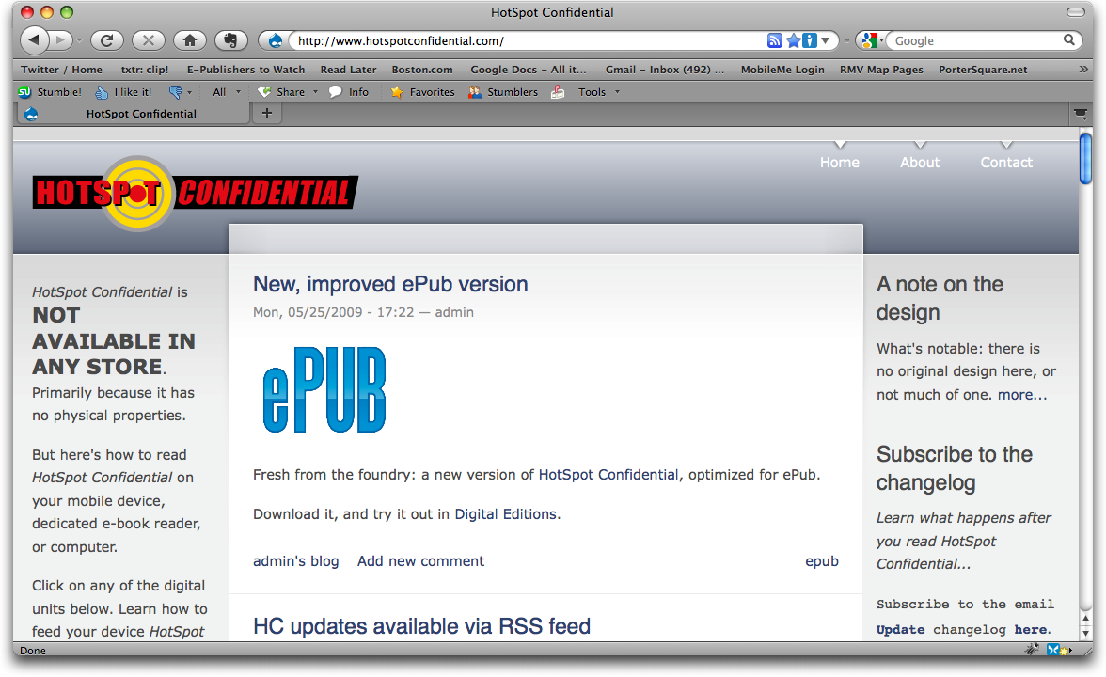

Slide 29
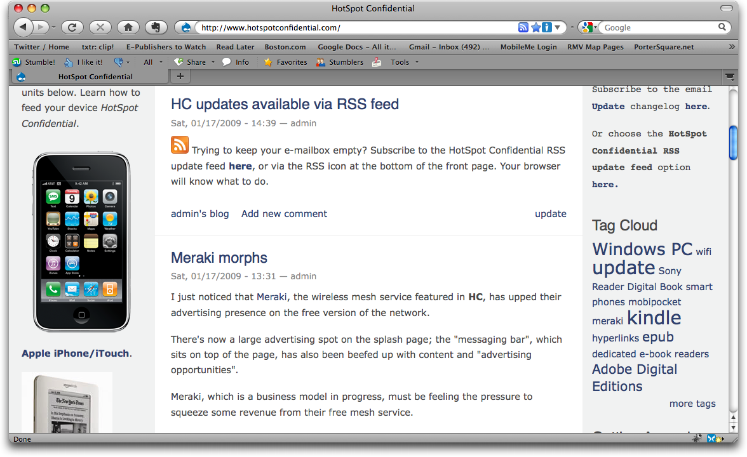

Slide 30
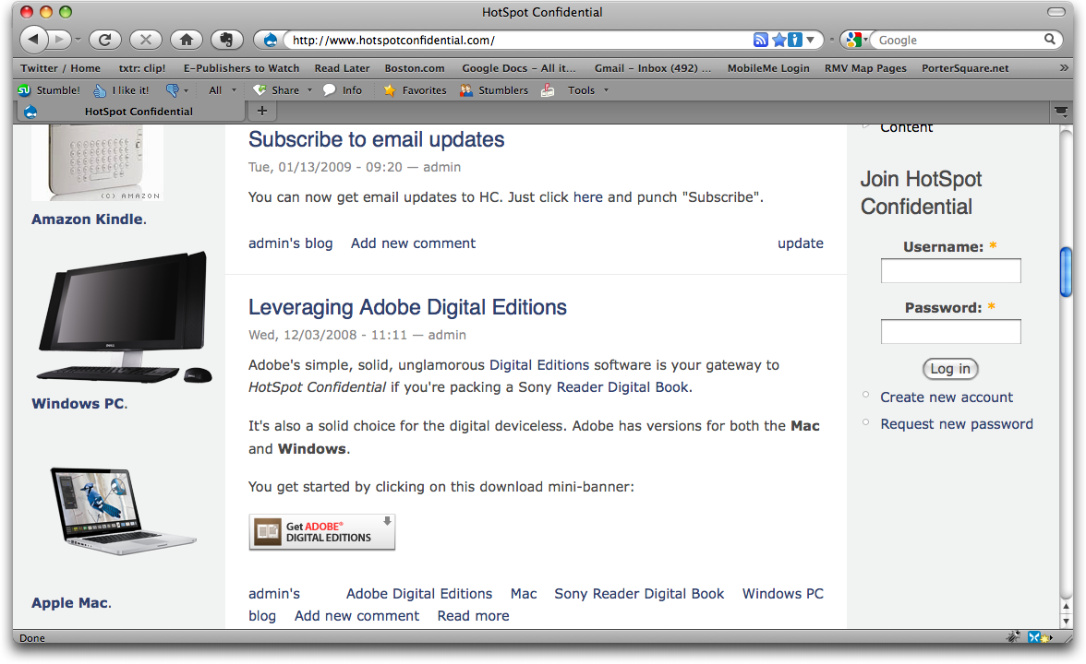

Slide 31
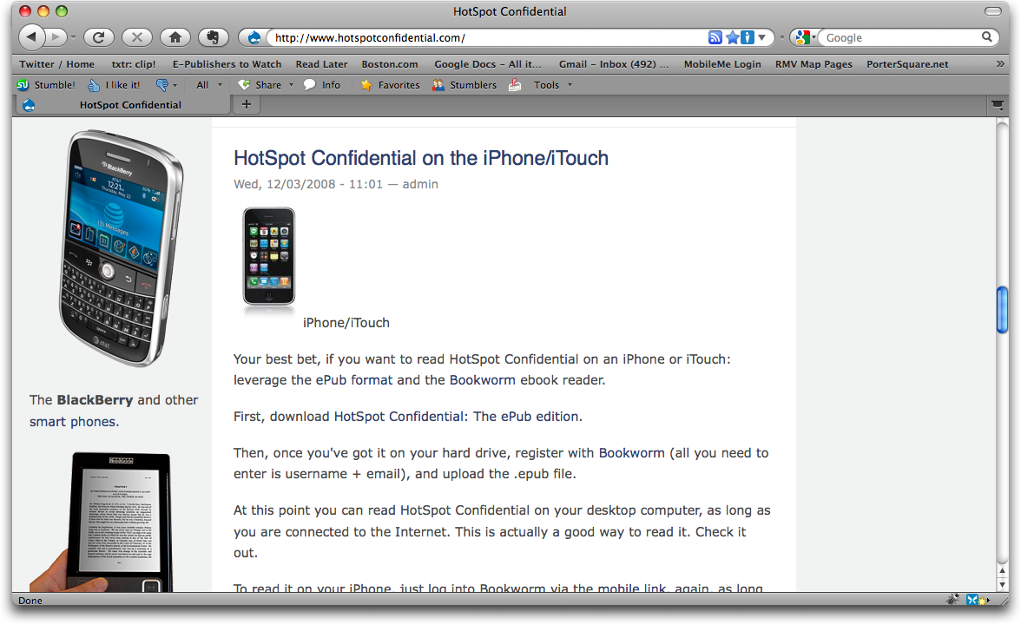

Slide 32


Slide 33
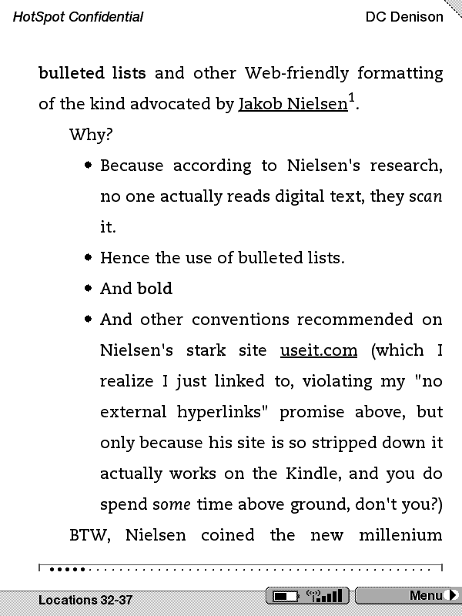

Slide 34
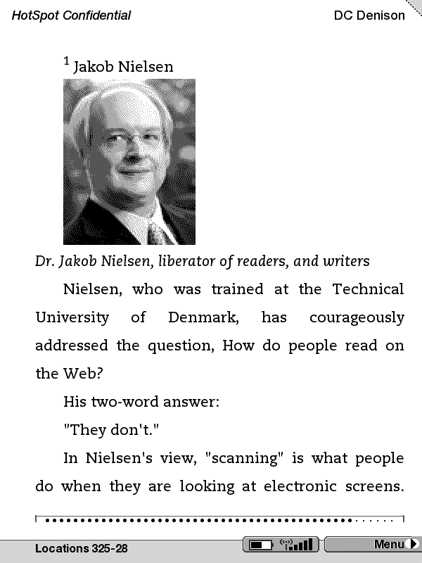

Slide 35
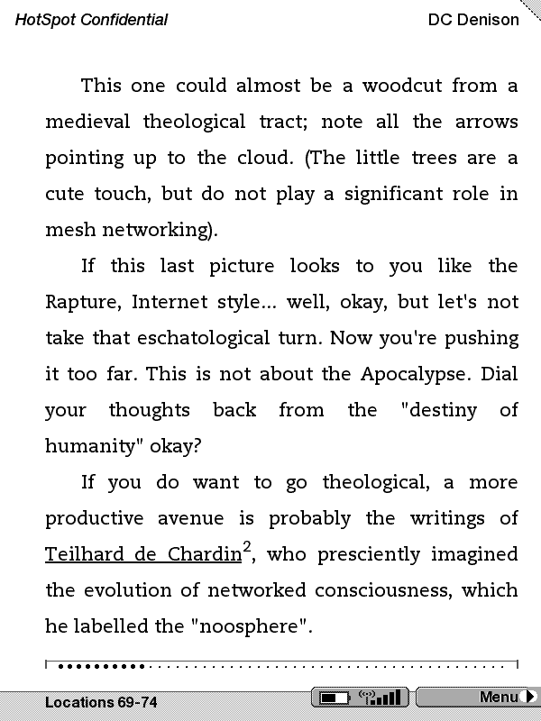

Slide 36


Slide 38
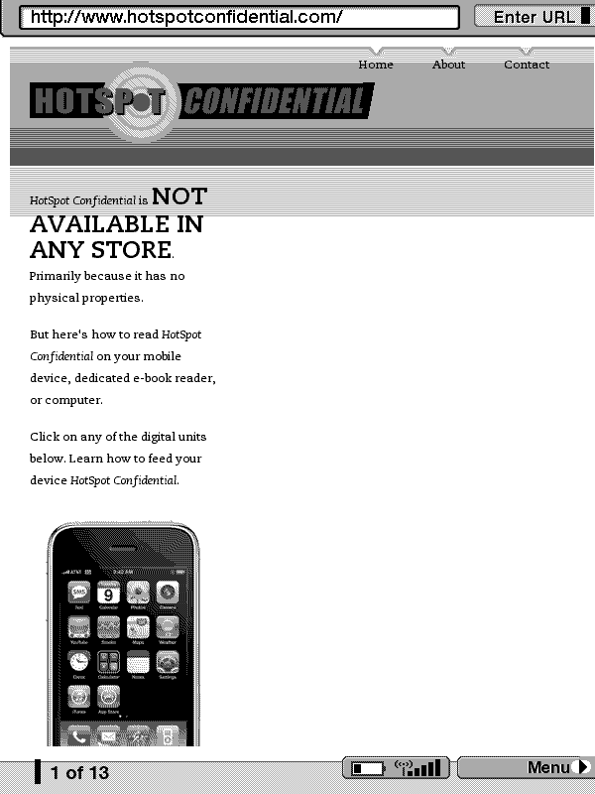

Slide 39
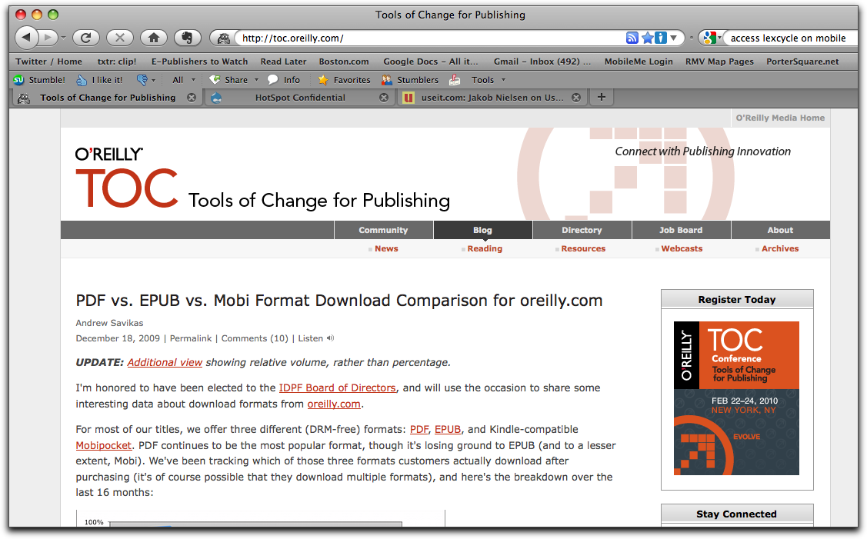

Slide 40
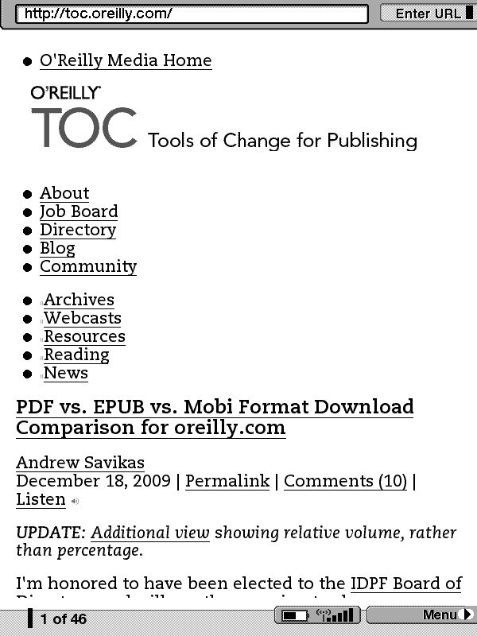

Slide 41
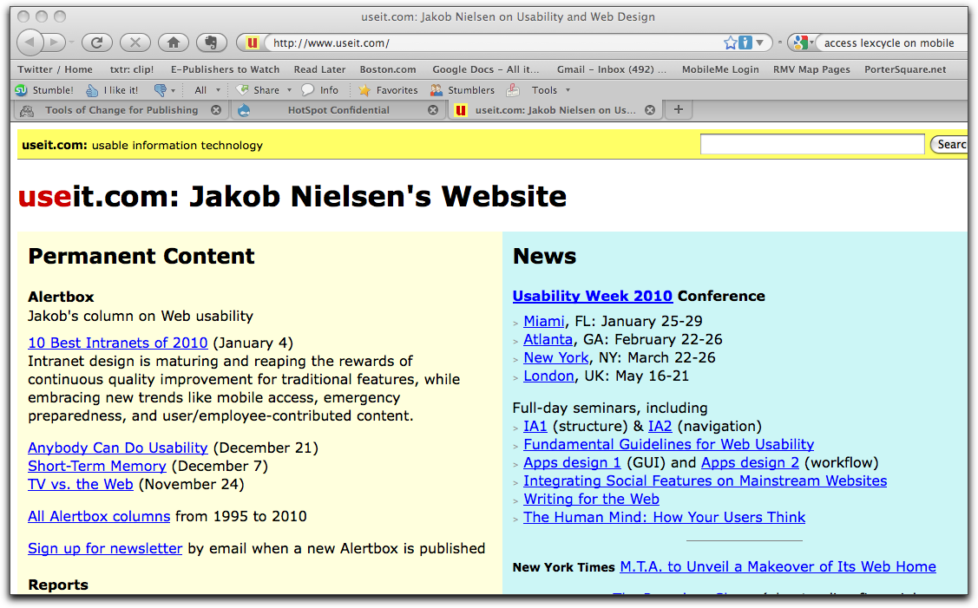

Slide 42
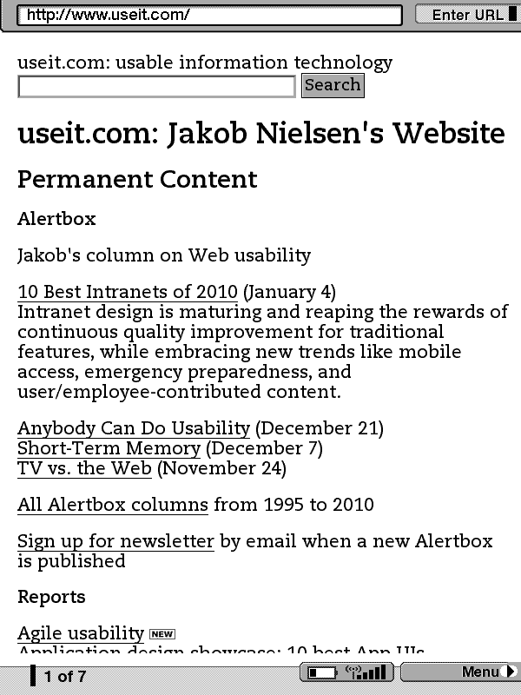

Slide 43
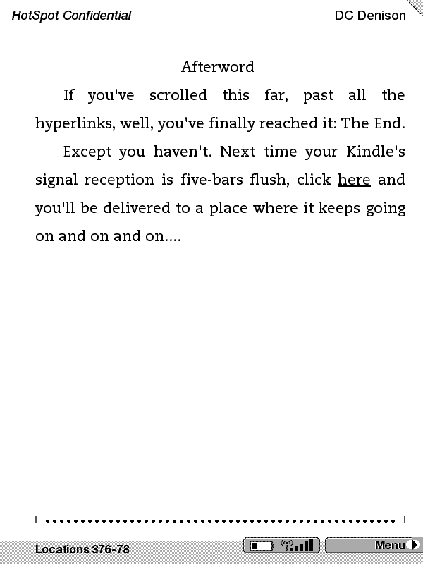

Slide 44
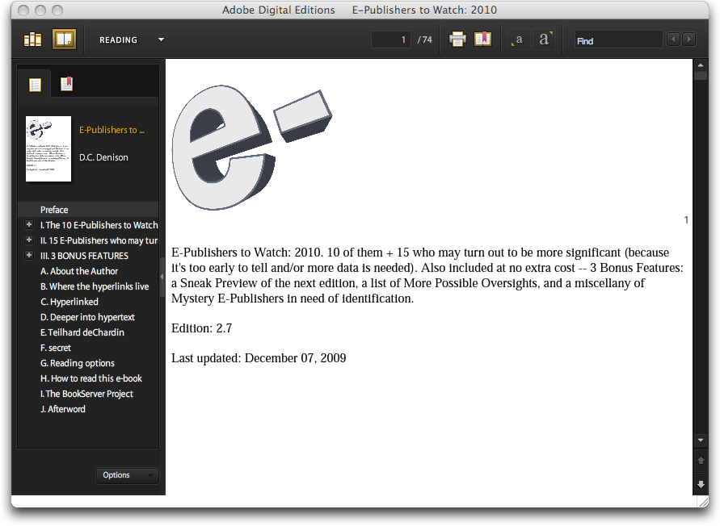

Slide 45
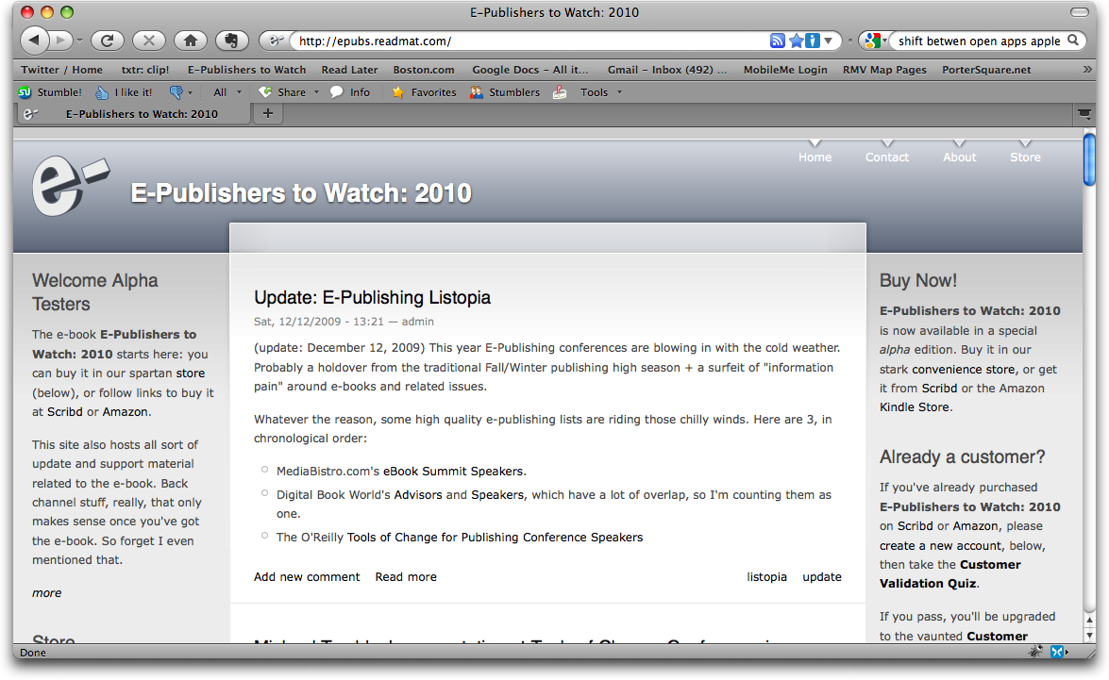
Notes:
Update this in February

Slide 46
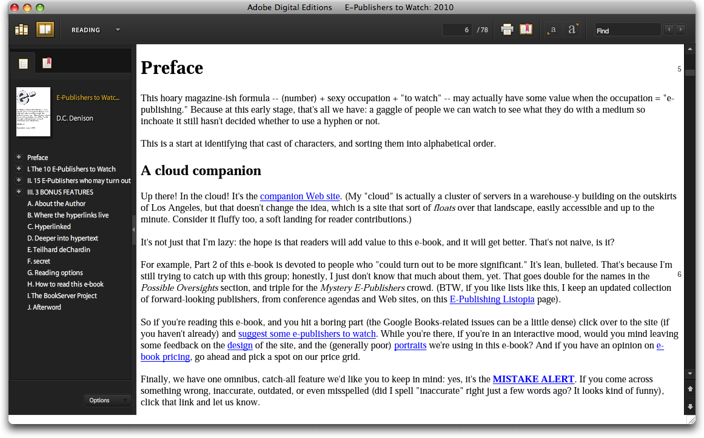

Slide 47
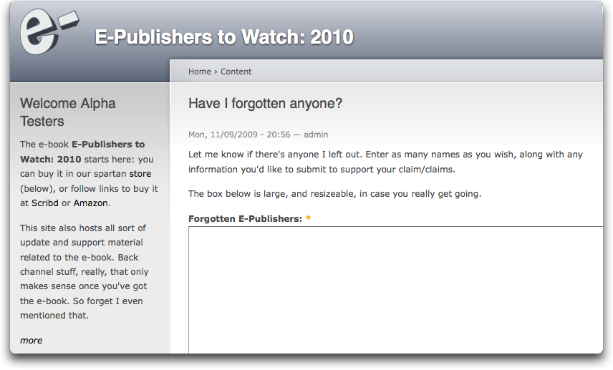

Slide 48
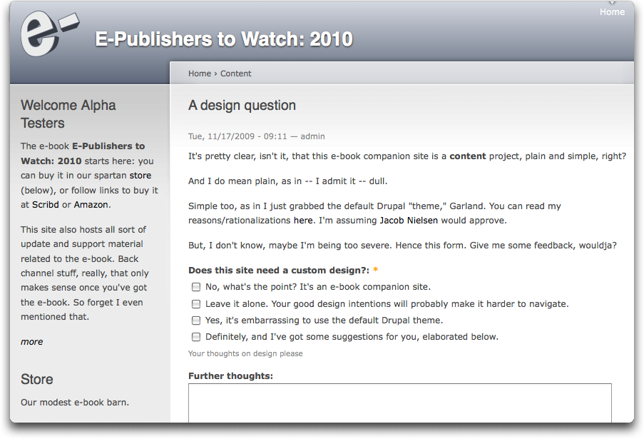

Slide 49
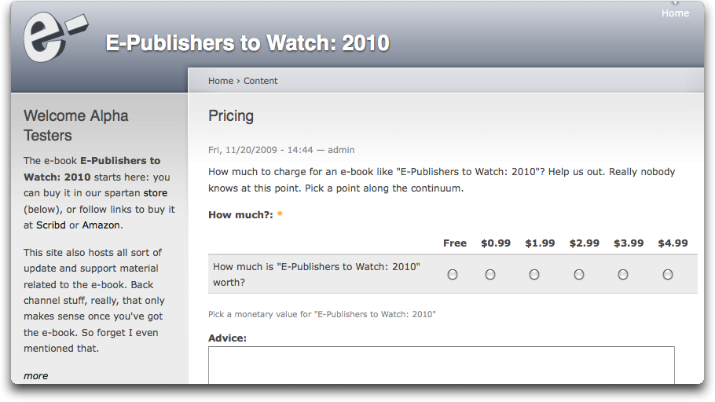

Slide 50
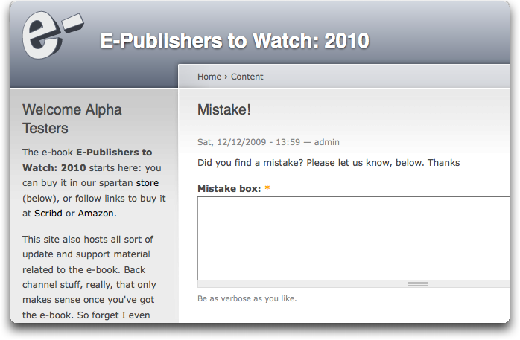

Slide 51
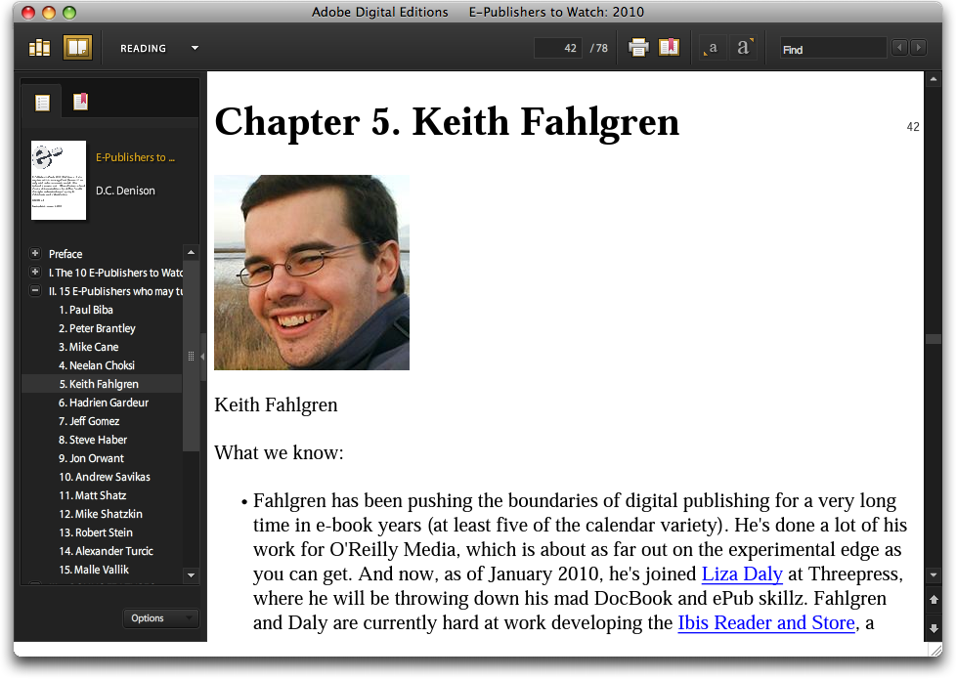
Notes:
NEW – Feb 7, 2010

Slide 52
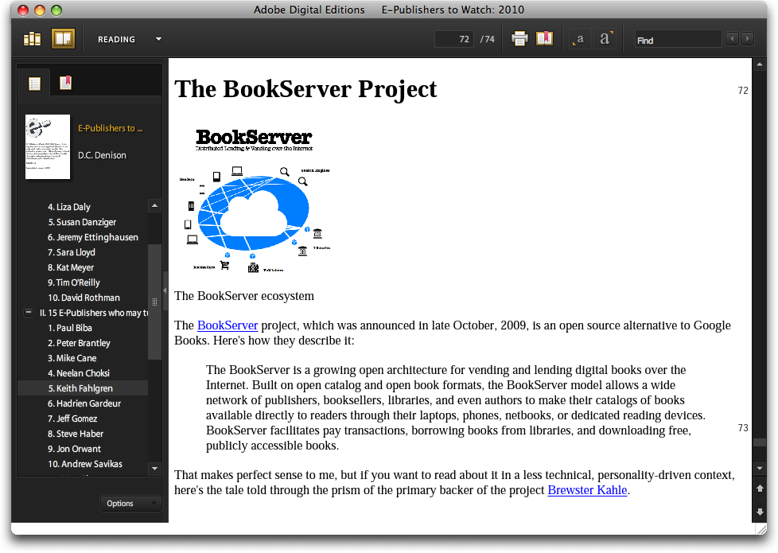
Notes:
NEW – Feb 7, 2010

Slide 53
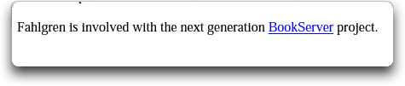
Notes:
NEW – Feb 7, 2010

Slide 54
Notes:
NEW – Feb 7, 2010

Slide 55
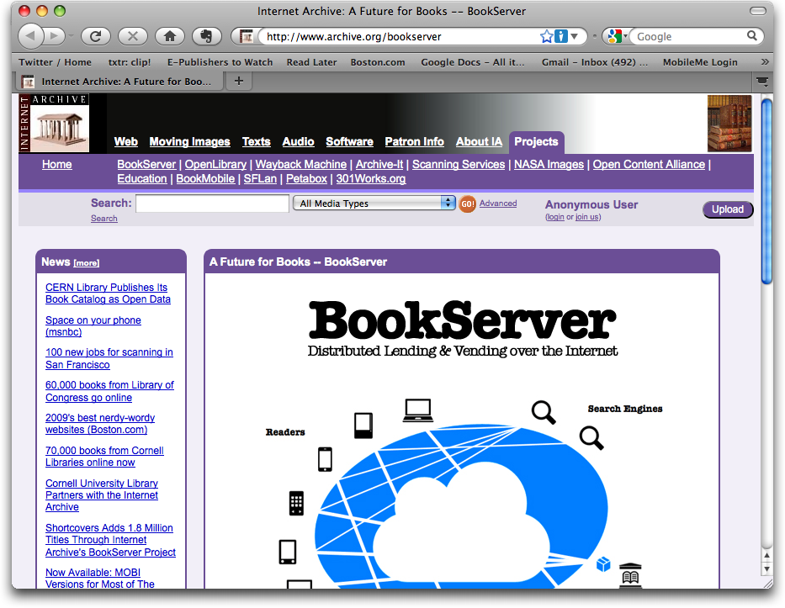
Notes:
NEW – Feb 7, 2010

Slide 56
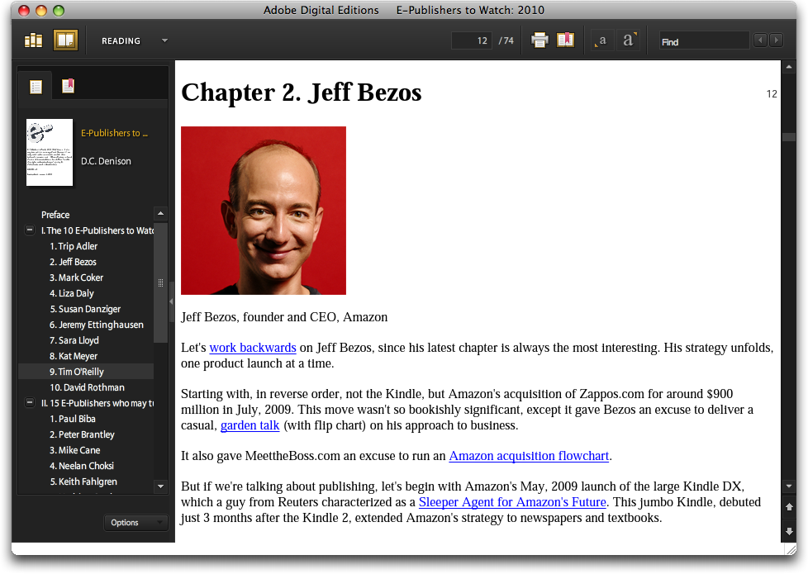
Notes:
NEW – Feb 7, 2010

Slide 57
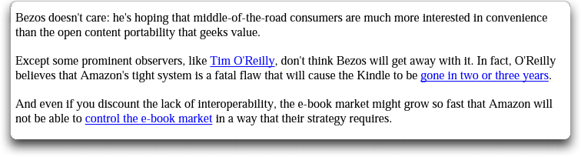
Notes:
NEW – Feb 7, 2010

Slide 58
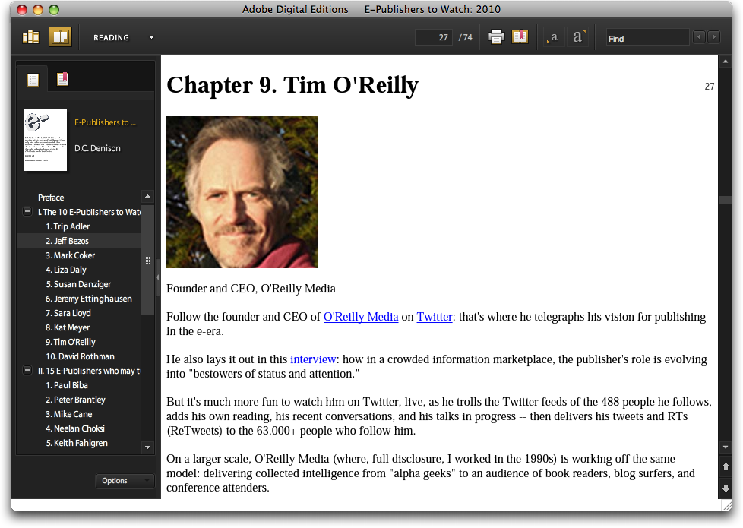
Notes:
NEW – Feb 7, 2010

Slide 59

Notes:
NEW – Feb 7, 2010

Slide 60
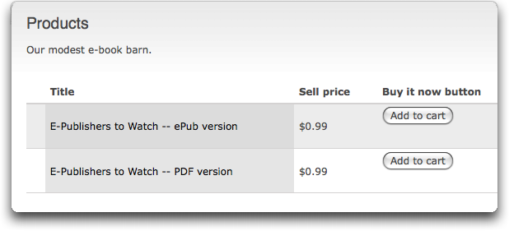

Slide 61
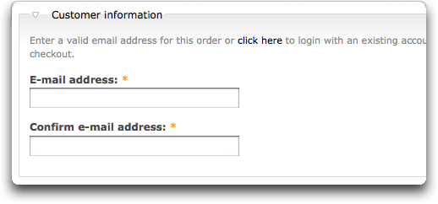

Slide 62
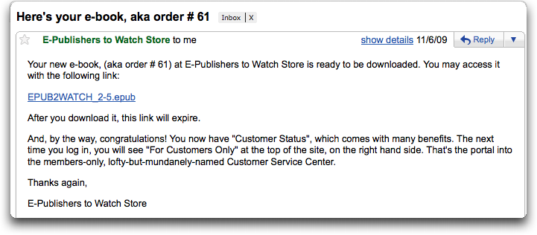

Slide 63
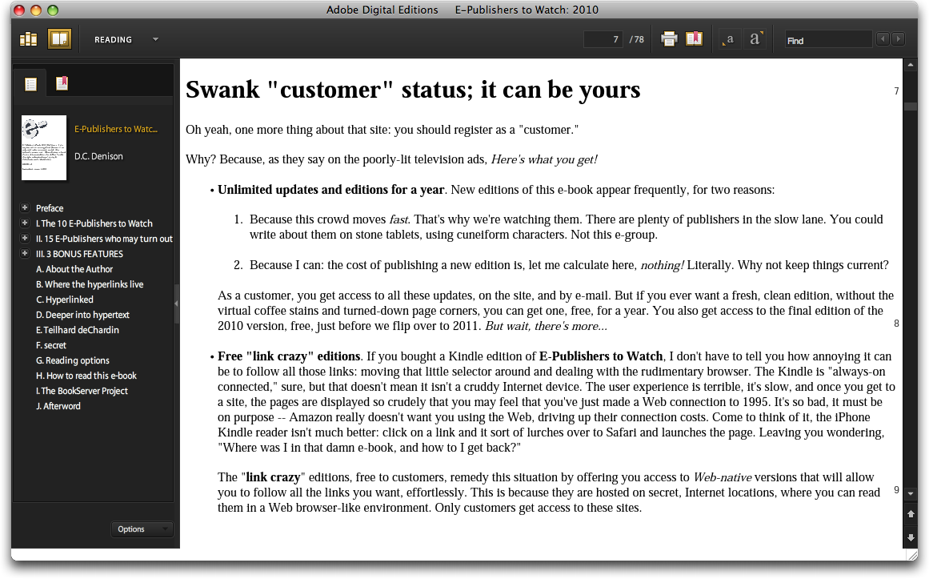

Slide 64
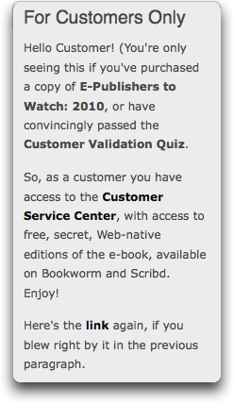

Slide 65
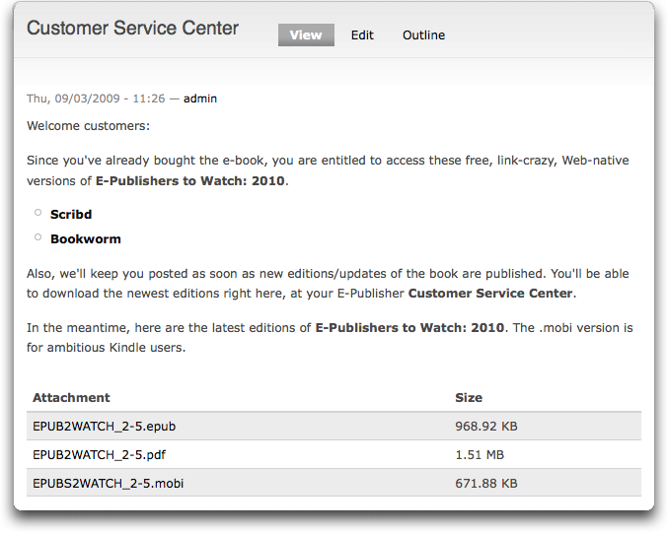

Slide 66
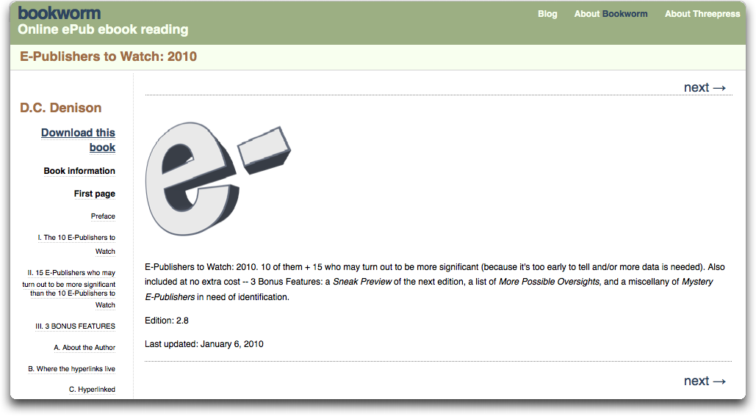

Slide 67
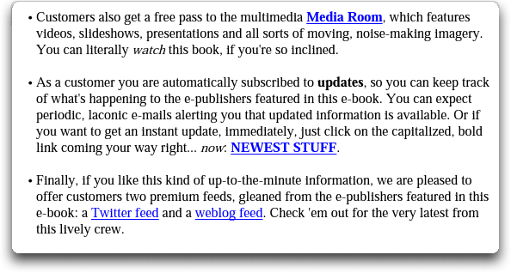

Slide 68
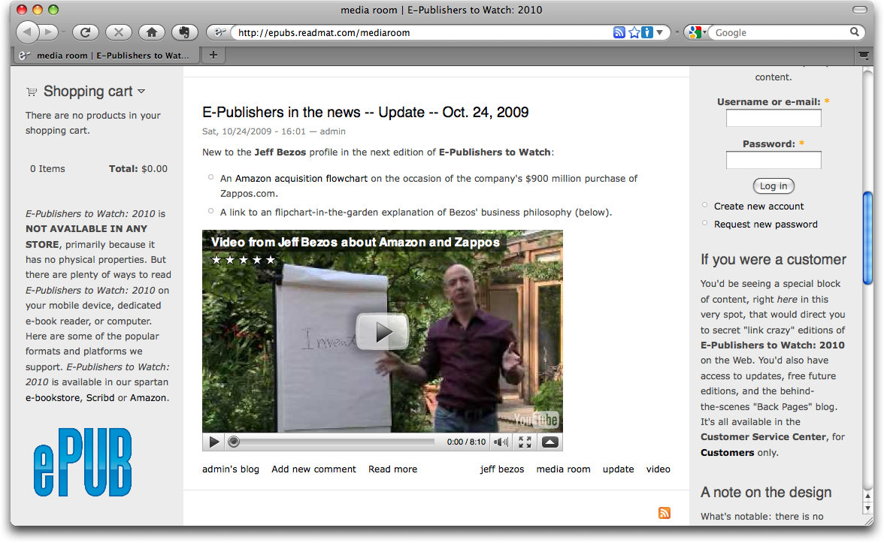

Slide 69
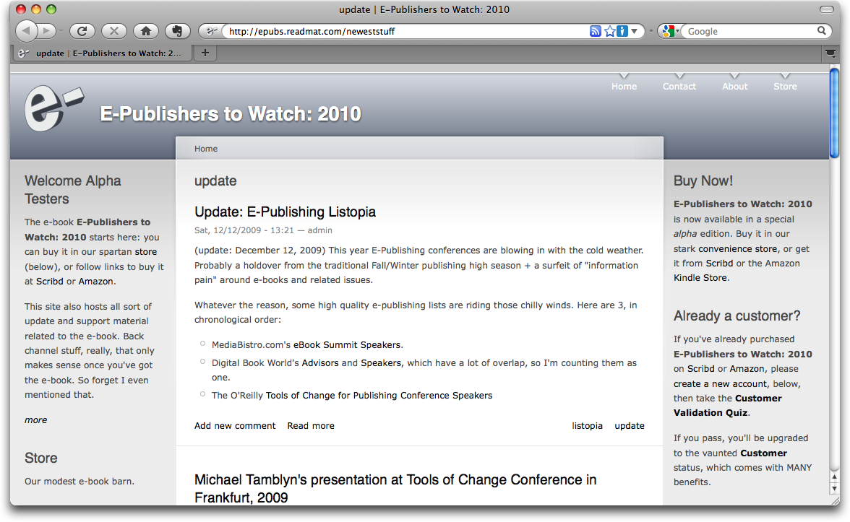

Slide 70
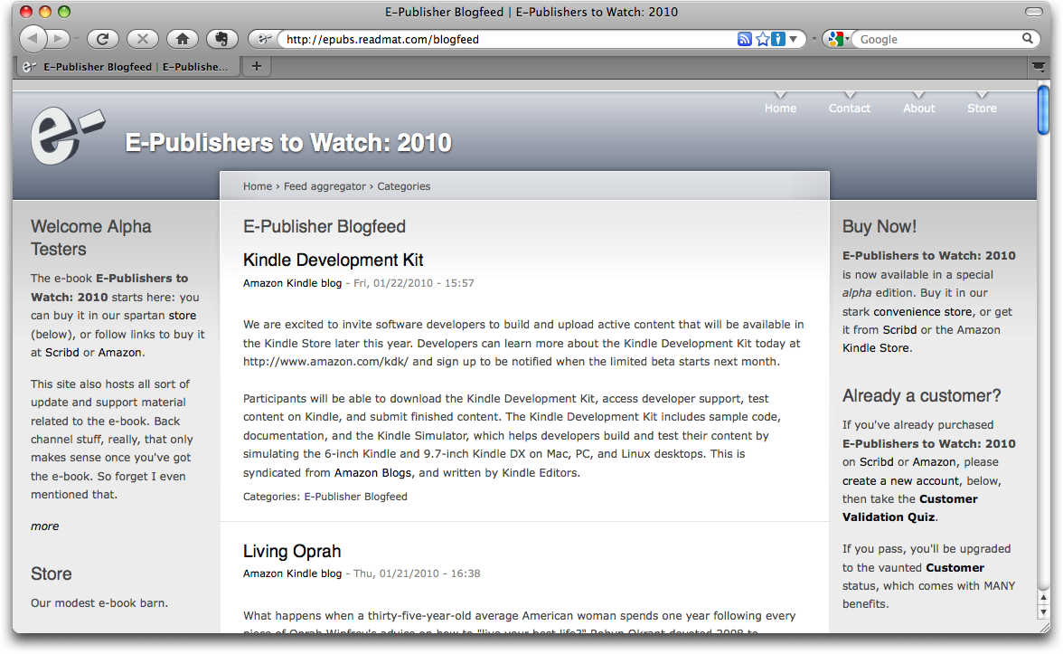

Slide 71
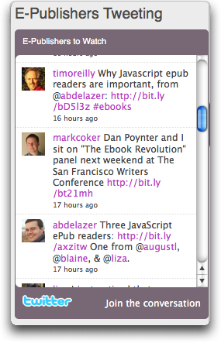
Notes:
NEW – Feb 7, 2010

Slide 72
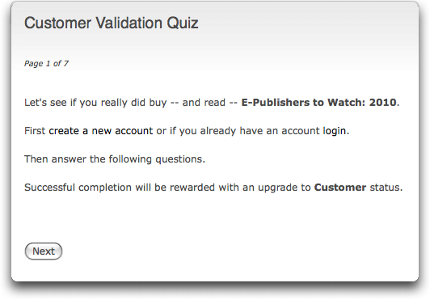

Slide 73
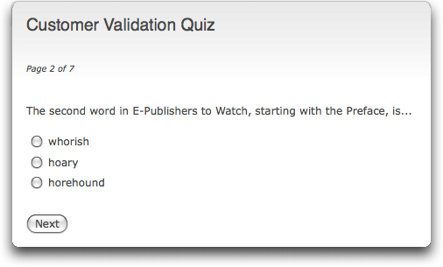

Slide 74
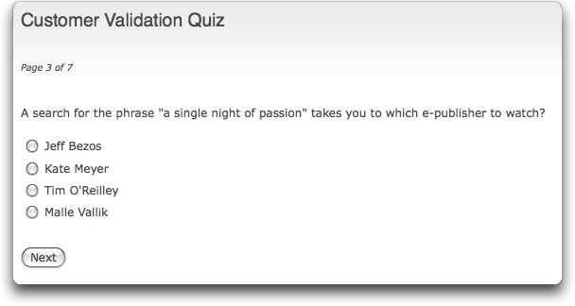

Slide 75
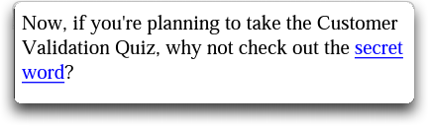

Slide 76
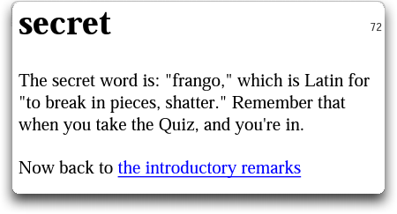

Slide 77
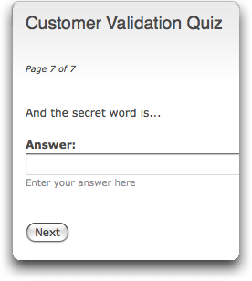

Slide 78
Lessons learned
Tighter integration with the Web
Updatable
Interactive, responsive
Digressions, amplifications
Access to source material
Access to new, alternate versions
Add multimedia elements
Notes:
NEW – FEB. 7, 2010

Slide 79
Challenges
The customer sign on is clunky
Can be difficult to go between ebook and web
Multiple formats and platforms
  ePub
  mobi
  azw
  Drupal

Slide 80
Some unexplored possibilities
Use the Web site for Search Engine Marketing
Host ads on the site
  Google AdSense
Host affiliate campaigns
  Amazon

Slide 81
Photos
jonno259
http://www.flickr.com/photos/jonno259/
sean dreilinger
http://www.flickr.com/photos/seandreilinger/
F. Yamada
http://www.flickr.com/photos/loxea/
Nick Starr
http://www.flickr.com/photos/nickstarr/
Colorblind Picaso
http://www.flickr.com/photos/colorblindpicaso/
Steve Rhodes
http://www.flickr.com/photos/ari/

Slide 82
Contact information
dcdenison@mac.com
http://www.hotspotconfidential.com
http://epubs.readmat.com

